Slide 1




NEAREST NEIGHBOUR OF DIFFERENT IMAGE REPRESENTATION
PRESENTED BY ANKUR CHOWDHURY (1911844042)
& Sajid Wasif (1912313642)

Slide 2

Problem
In this project for every picture in the dataset one dimensional vector will be created and stored in the program. For each and every picture it will show 10 pictures in Euclidean distance or we can say 10 nearest neighbors.
For this project we are going to use the ImageNet dataset https://www.kaggle.com/competitions/imagenet-object-localization-challenge/data?select=ILSVRC
The main part for this project is to observe different types of objects and what their nearest neighbors represent the similar picture or different types of pictures and also the similarity rate for those pictures.

Slide 3
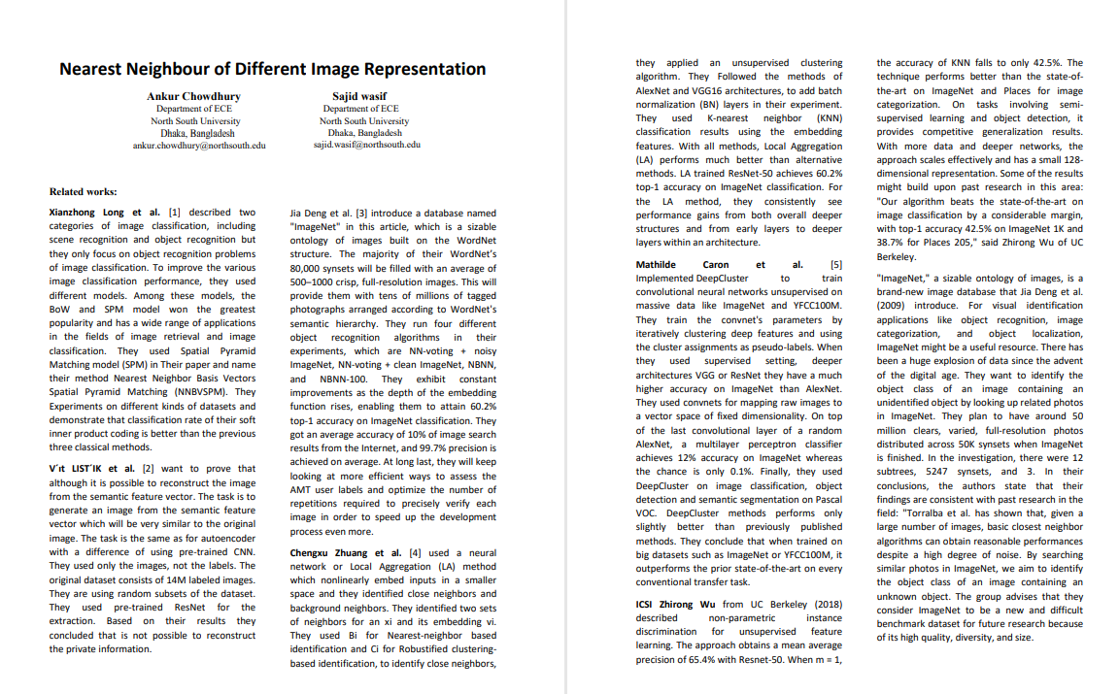
Related Works

Slide 4
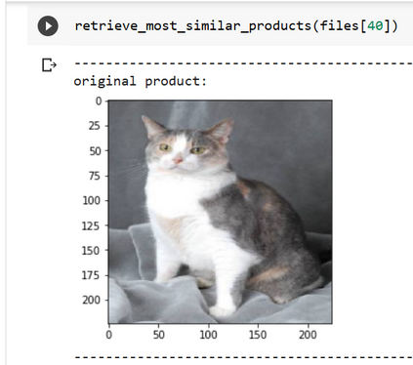
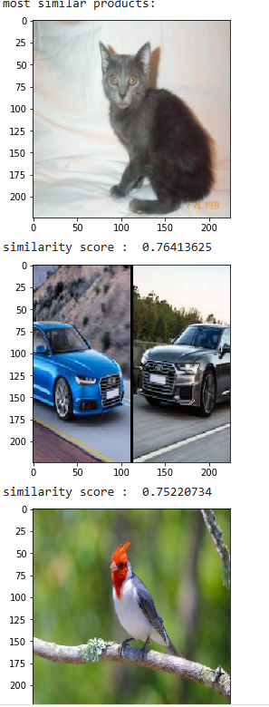
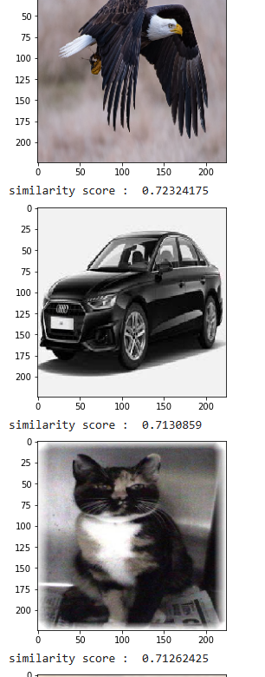
Approaches of Solving The Problem
Divided the dataset into 10 classes. Every class contains 100 images.
Imported the model Resnet101.
Extracted features of the images by using two models (Resnet101 & VGG16 ).
The cosine similarity score was used to determine the similarity between the images.
Compared accuracy between two models and decided to continue with Resnet101 as it gave better accuracy.
In the output section of ResNet 101 the original image was Cat, and from the 10 nearest neighbors, we got 5 similar photos .

Slide 5
Challenges
The ImageNet dataset is almost 2 million pics which was not possible at the time to train. So, we trained our own dataset containing 4 to 5 categories for which the similar imager that was output was coming according to those categories only. So, we had to increase the amount of dataset gradually.
The output was not displayed properly since the dataset was not properly trained.
We used the Resnet101V2 model to train the dataset in our initial try. However, we were not achieving the level of accuracy that we had hoped for. The similarity score rate was nearly 60-70%. As a result, we needed to alter the model.
Output was not that much strong than we thought (for a cat pic we were getting 2 cat pics,3/4 car pics,2 bird pics etc.) so we had to increase the accuracy in order to get a good output.

Slide 6
Teamwork
From the beginning of this course, we started our teamwork from project topic selection and the approaches we should follow to complete the project.
During the model training we have faced some problems which we solved together. To bring more accuracy we modified the model.
We always divided work when we needed and got together when we couldn’t solve something or come to a conclusion. When one of us couldn’t attend do perform any work other member made sure he covered that for him
In this very way, we have maintained our teamwork and completed a part of the project successfully.
We had to utilize the VGG16 model alongside with Resnet101V2 model in order to achieve higher similarity of 82%.

Slide 7
Future plan
We currently used two models but in future we want to try different models like ZFnet and other CNN modes for better similarity score.
We used our own dataset which was not efficient enough so we want to gradually shift the dataset to the ImageNet dataset as soon as possible.
We will observe the reason of why similar images are being different object than the input object.
Other than this if sir gives us any specific task or wants us to add something to the project we will do so.

Slide 8
Conclusion
After overcoming certain obstacles, we have thus far achieved our desired outcome from the project.we investigate how deep learning methods may be used to create a feature extractor model and obtain the most comparable photos from a dataset of 10 classes of 1000 different image.The features were then extracted from the images and stored in a feature vector. In future we intend to our work with using some new methods.

Slide 9
THANK YOU

